Slide 1

Camunda Platform 8
Parameswari Ettiappan

Slide 2
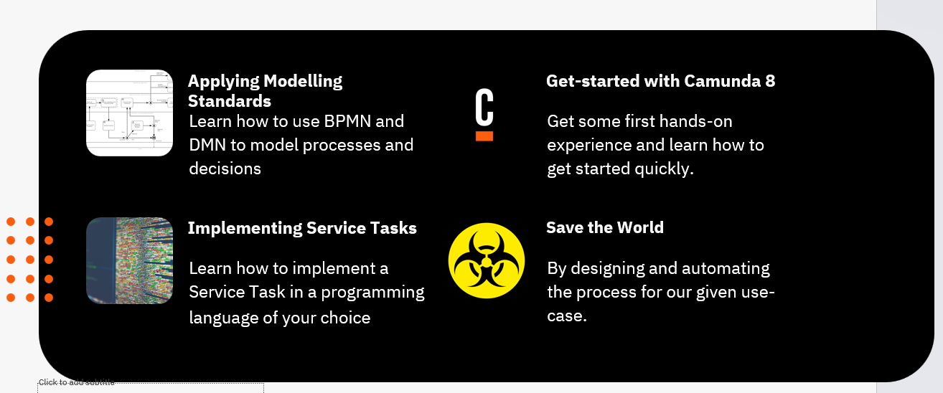
Goals

Slide 3



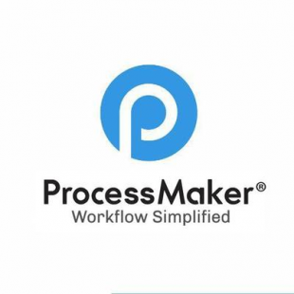






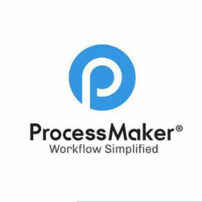


Business Process Management Platforms
Cloud Pak Automation
Bizagi

Slide 4
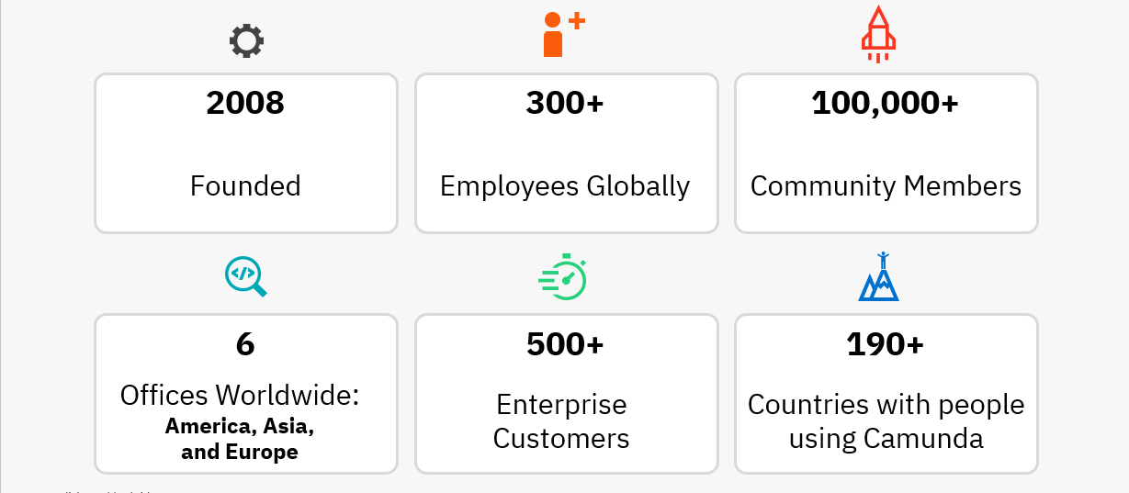
About Camunda

Slide 5
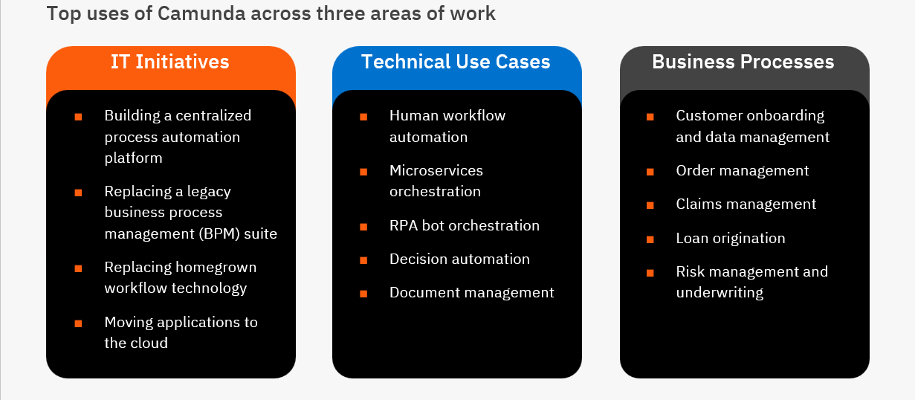
Common Camunda Uses

Slide 6
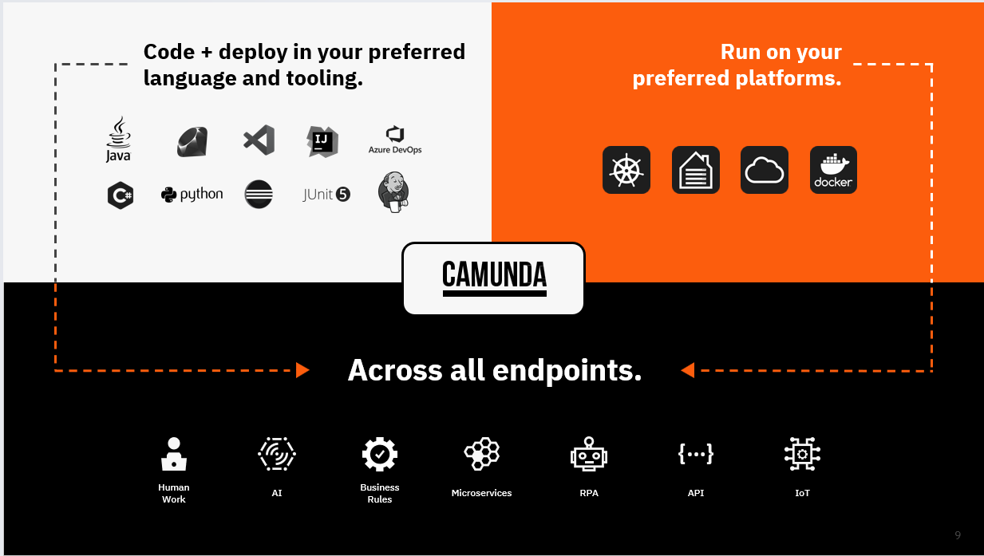

Slide 7
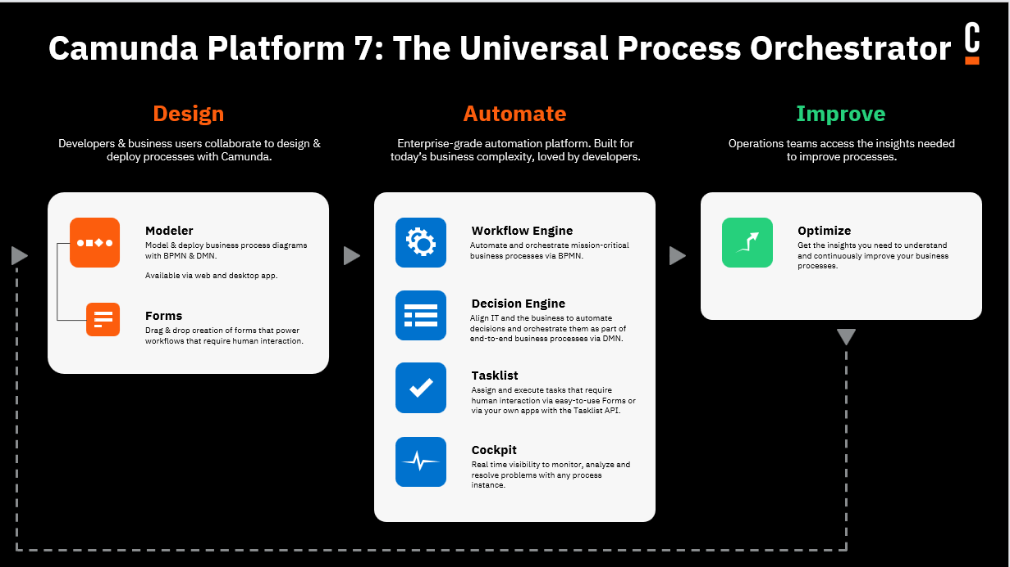

Slide 8
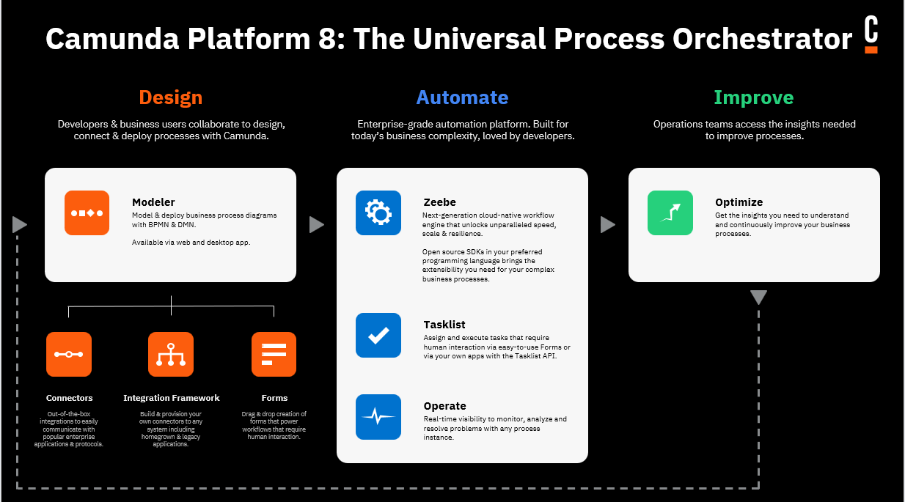

Slide 9
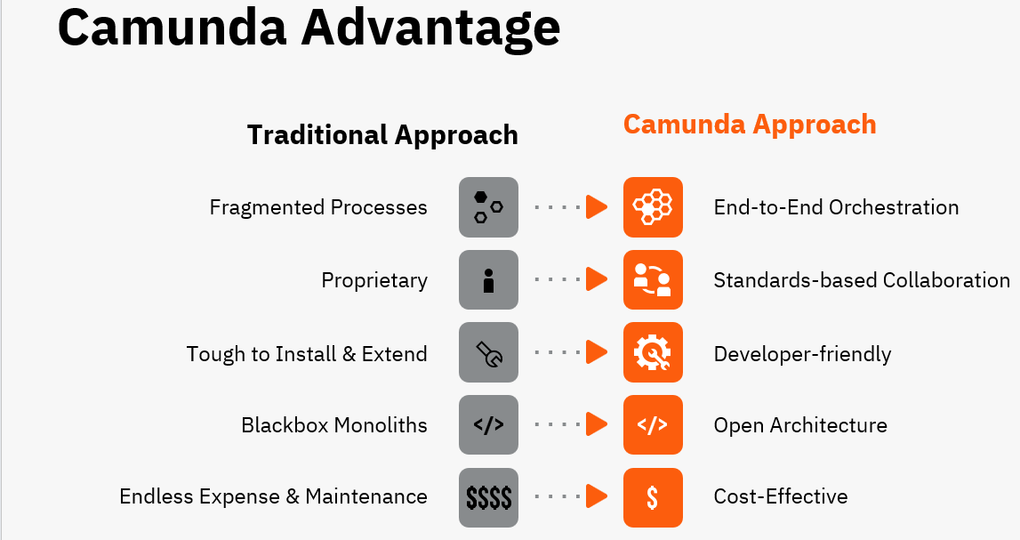

Slide 10
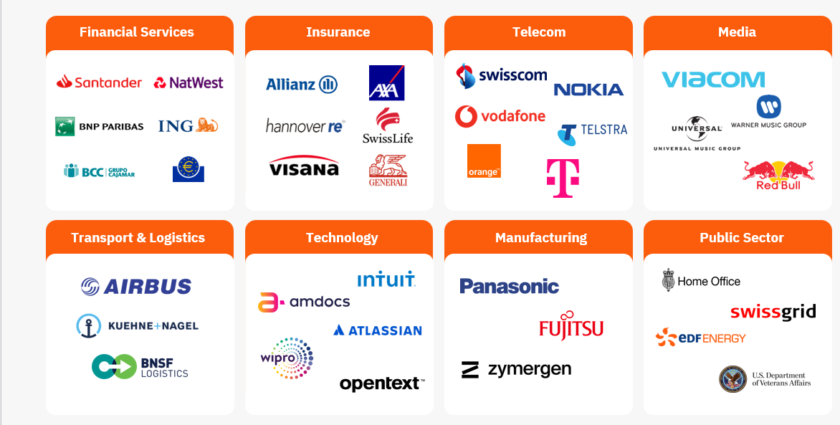
Customers

Slide 11
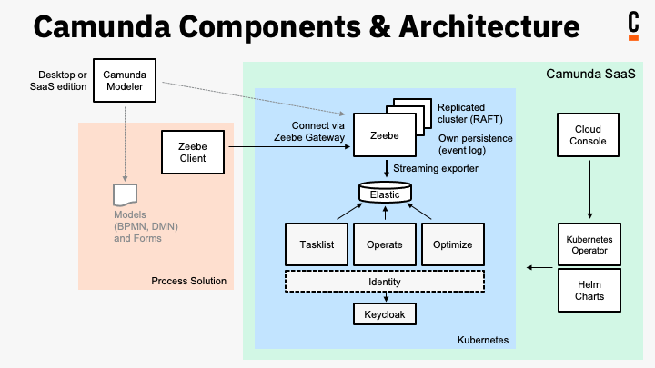
Camunda 8 Architecture

Slide 12
Camunda 8 Core Quality Attributes
Horizontal scalability
High availability and fault tolerance
Audit trail (History of the Process States)
Reactive publish-subscribe interaction model
Visual processes modeled in ISO-standard BPMN 2.0
Language-agnostic client model
Operational ease-of-use

Slide 13
Pre-migration details
No embedded engine in Camunda 8
In Camunda 7, you can store different data types, including serialized Java objects.
Camunda 8 only allows storage of primary data types or JSON as process variables.
This might require some additional data mapping in the code when you set or get process variables.
Camunda 7 provides Camunda Spin to ease XML and JSON handling. This is not available with Camunda 8

Slide 14
Pre-migration details
Camunda 7 uses Java Unified Expression Language (JUEL) as the expression language.
In the embedded engine scenario, expressions can even read into beans (Java object instances) in the application.
Camunda 8 uses Friendly-Enough Expression Language (FEEL) and expressions can only access the process instance data and variables.

Slide 15
Pre-migration details
Through Camunda Connect, Camunda 7 provides an HTTP and a SOAP HTTP Connector.
Camunda 8 offers multiple Connectors out-of-the-box.
To migrate existing Connectors, consider the following options:
Use the REST protocol Connector to leverage an out-of-the-box Connector.
Create a small bridging layer via custom job workers.

Slide 16
Pre-migration details
With Camunda 7, a frequented architecture to build a process solution (also known as process applications) is composed out of:
Java
Spring Boot
Camunda Spring Boot Starter with embedded engine
Glue code implemented in Java delegates (being Spring beans)

Slide 17
Pre-migration details
With Camunda 8, a comparable process solution would look like the righthand side of the picture and leverage:
Java
Spring Boot
Spring Zeebe Starter (embedding the Zeebe client)
Glue code implemented as workers (being Spring beans)

Slide 18
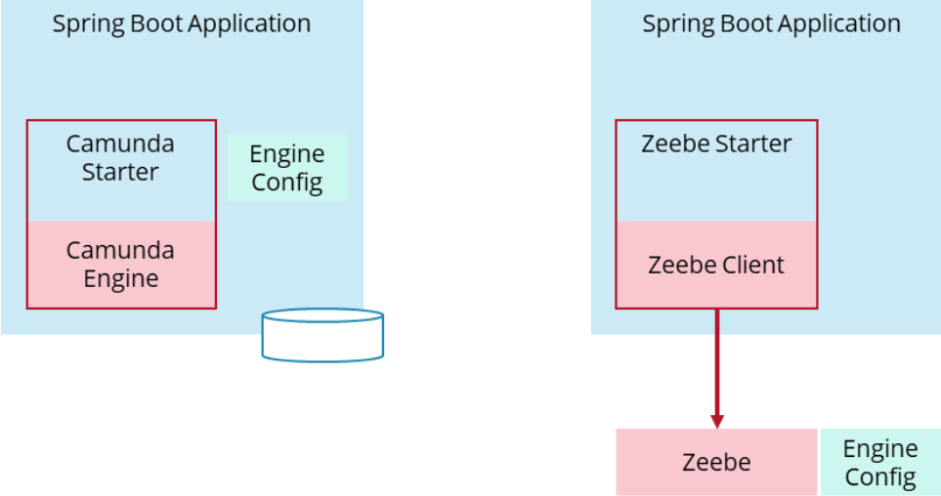
Pre-migration details

Slide 19
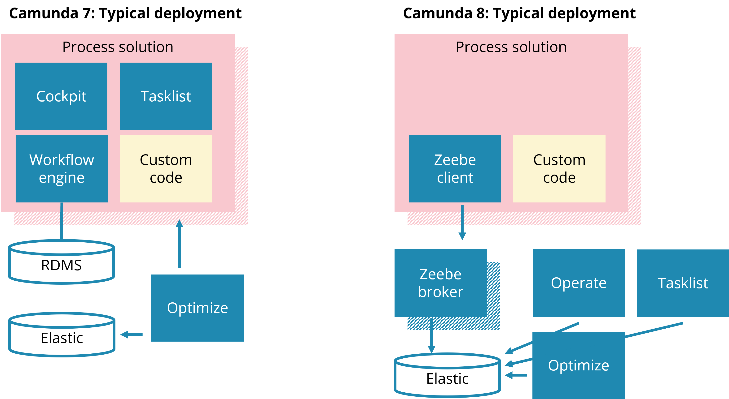
Pre-migration details

Slide 20
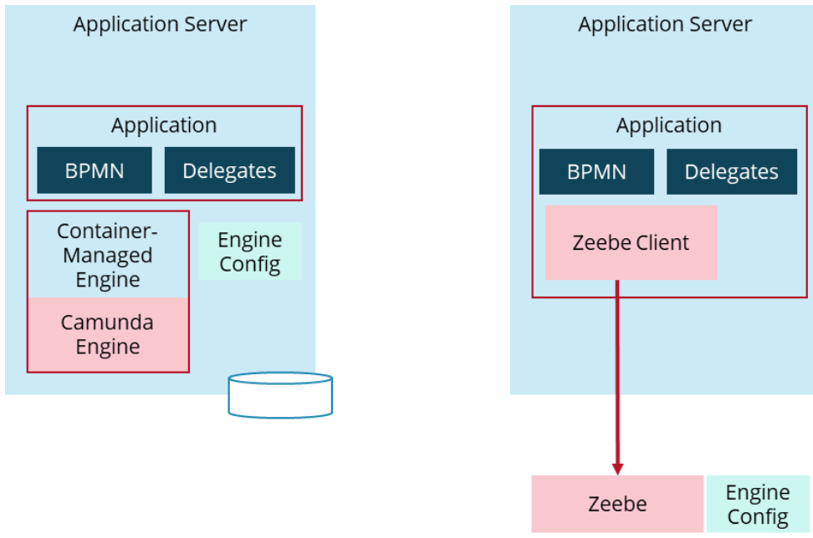
Pre-migration details

Slide 21
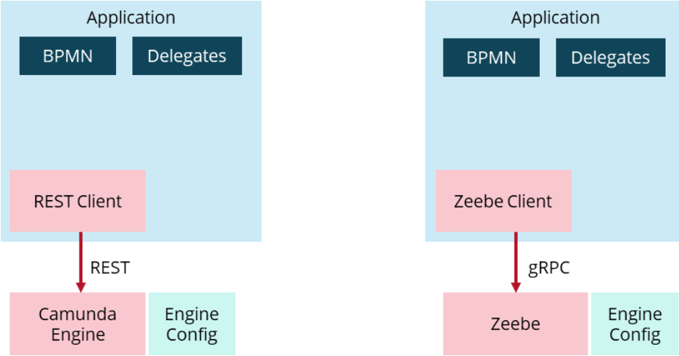
Pre-migration details
C# and Nodejs

Slide 22
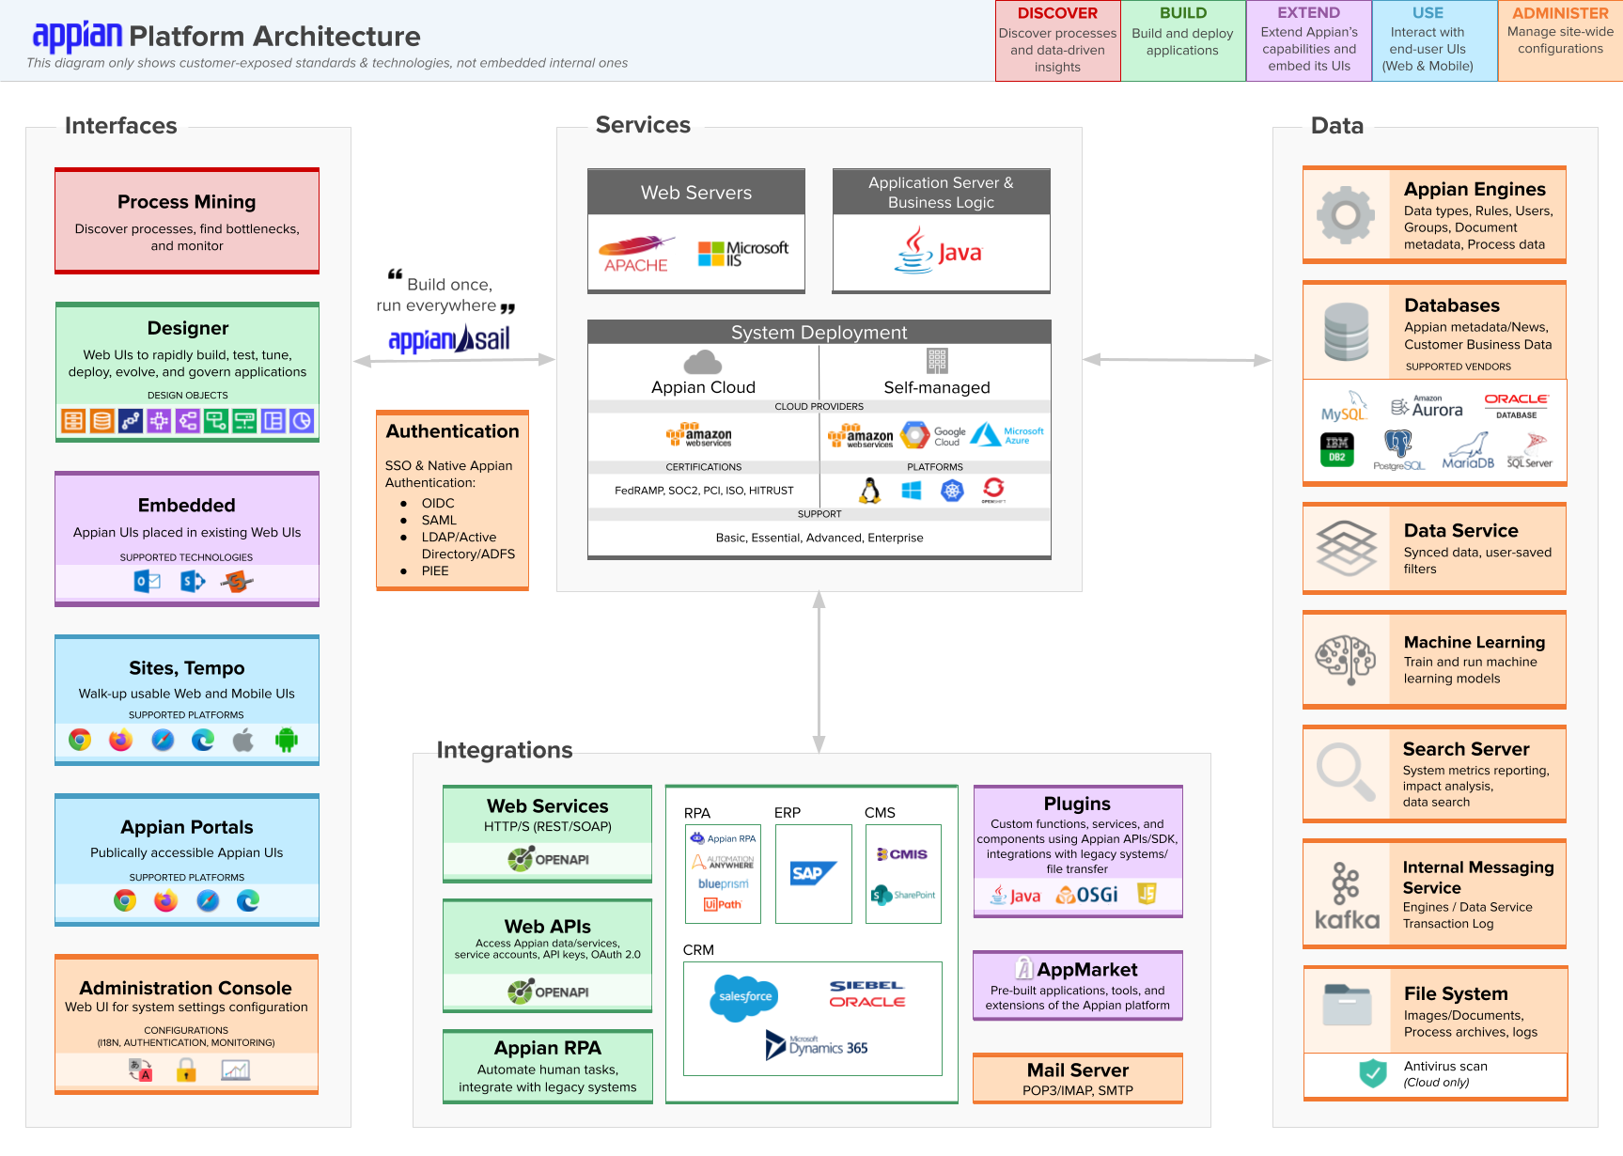

Slide 23
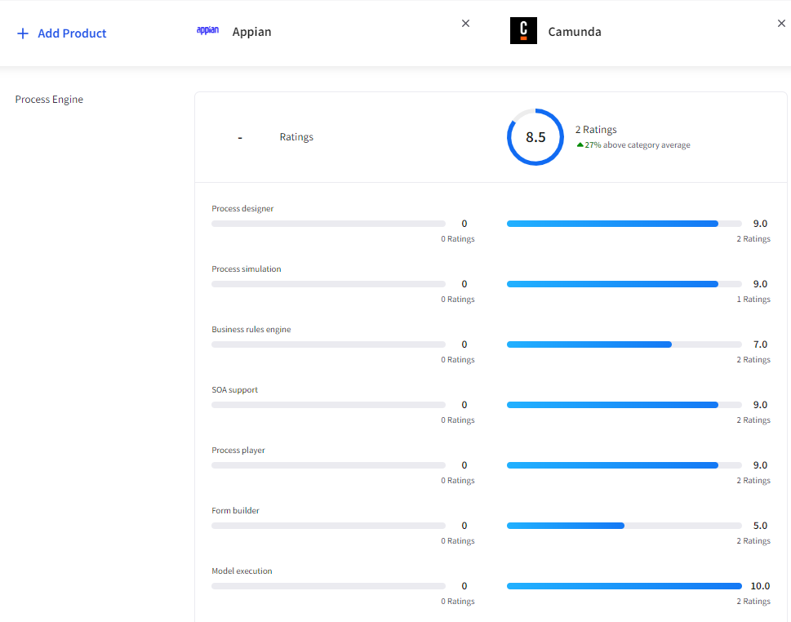

Slide 24
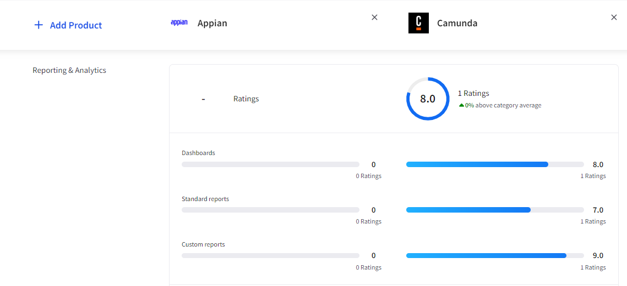
Appian vs Camunda

Slide 25
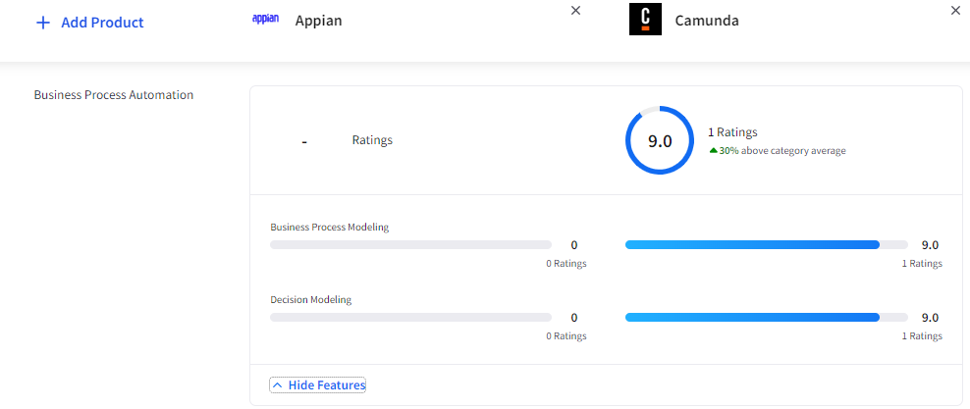
Appian vs Camunda

Slide 26
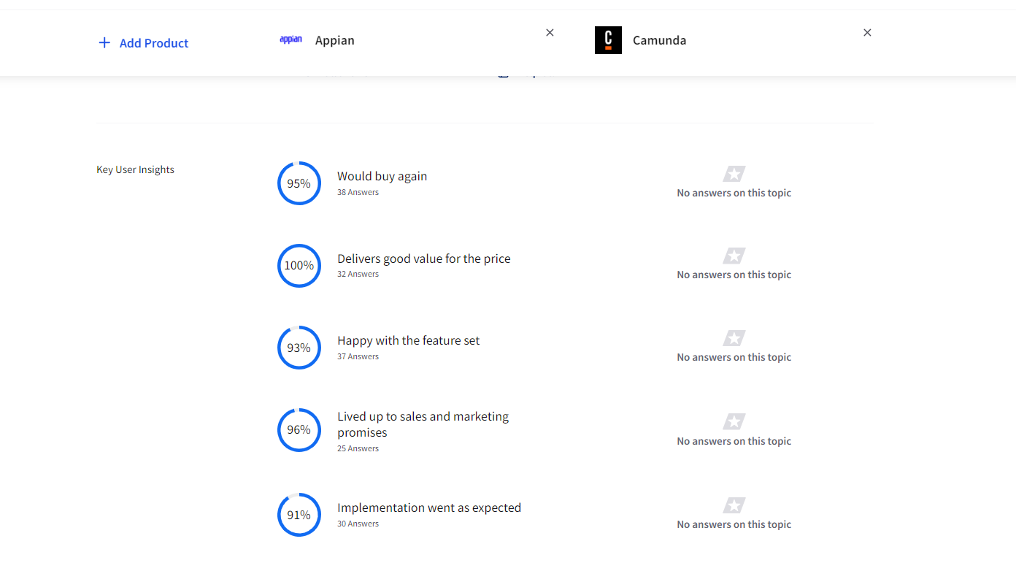
Appian vs Camunda

Slide 27
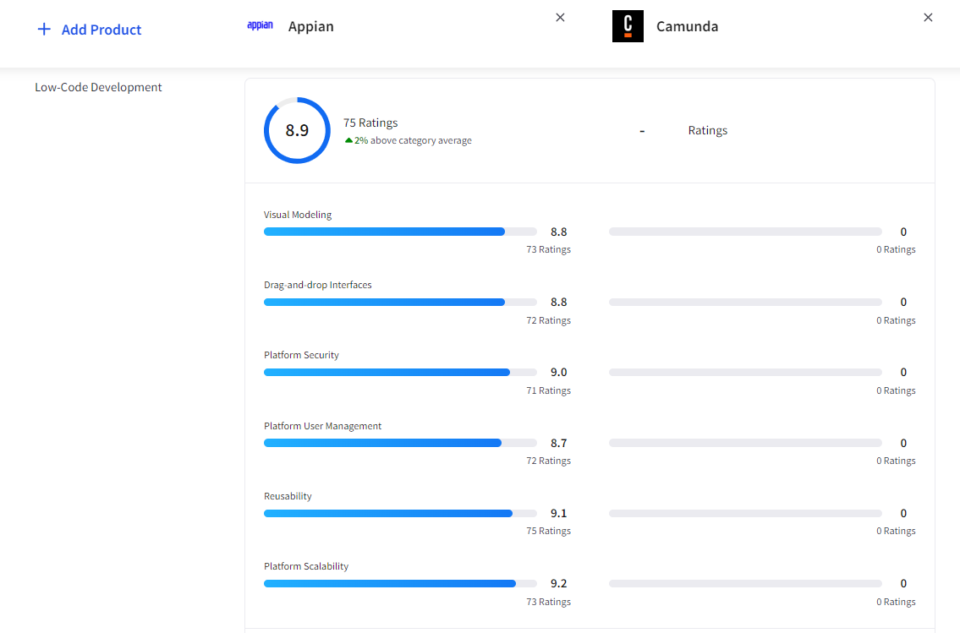
Appian vs Camunda

Slide 28
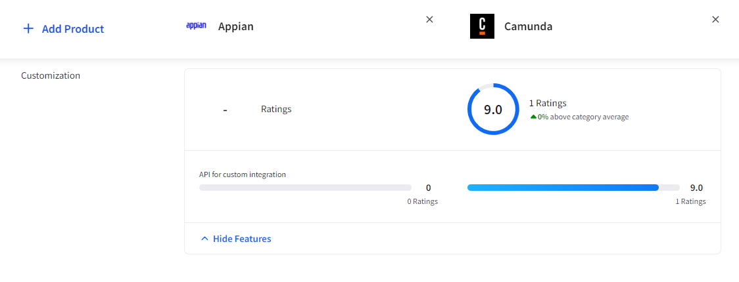
Appian vs Camunda

Slide 29
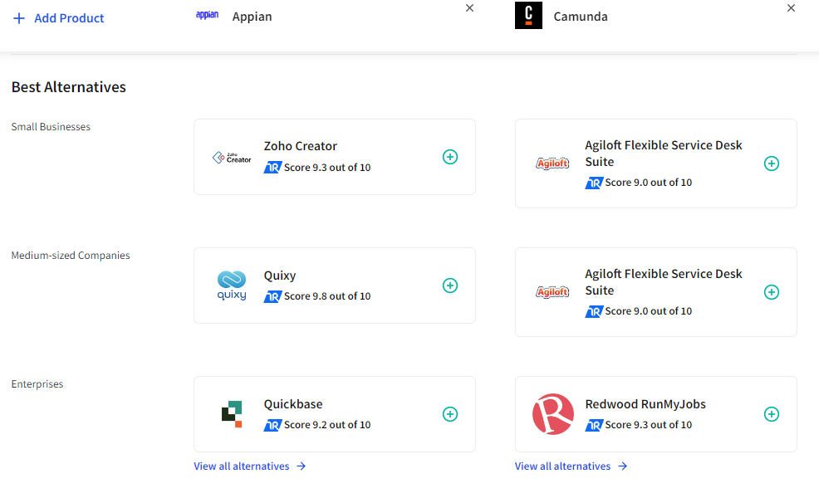
Appian vs Camunda

Slide 30
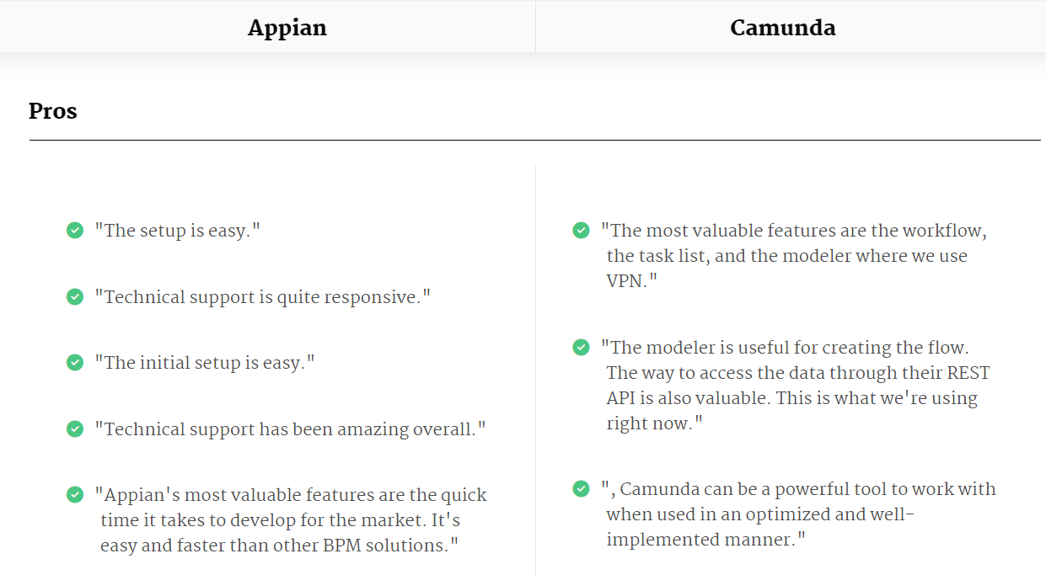
Appian vs Camunda

Slide 31
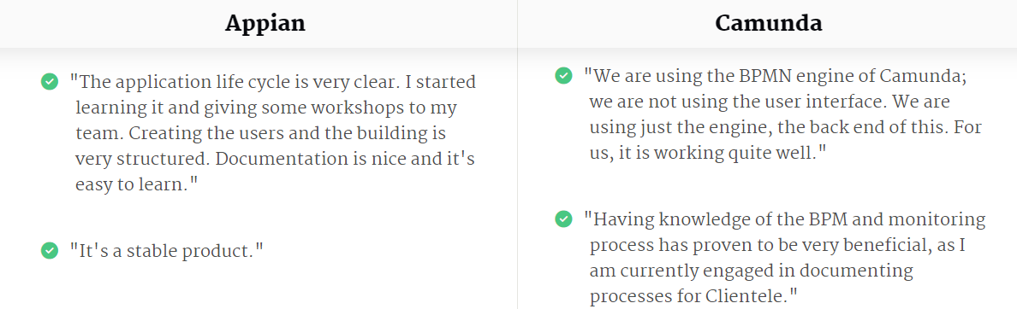
Appian vs Camunda

Slide 32
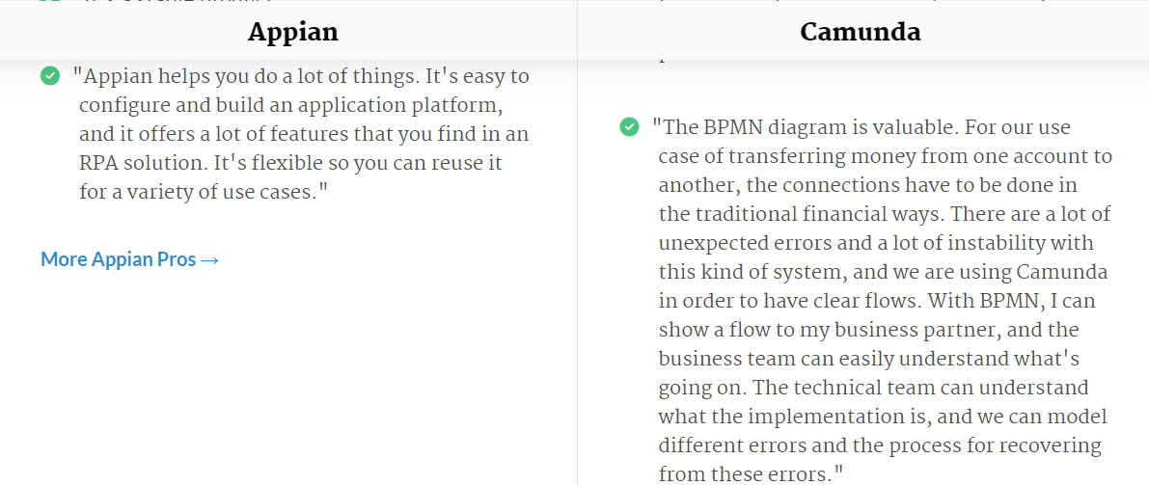
Appian vs Camunda

Slide 33
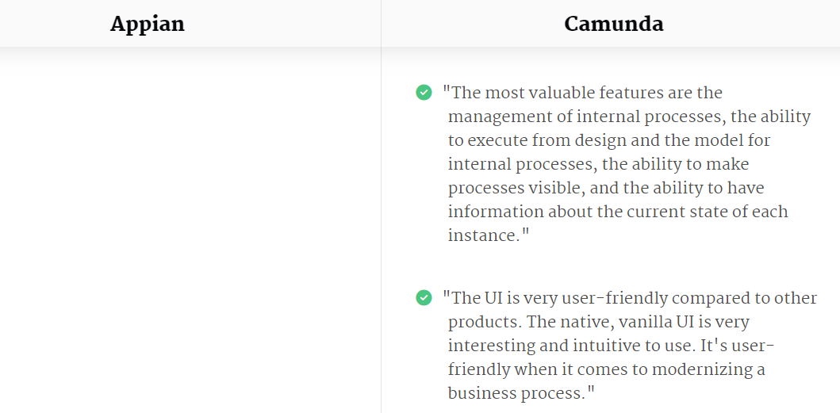
Appian vs Camunda

Slide 34
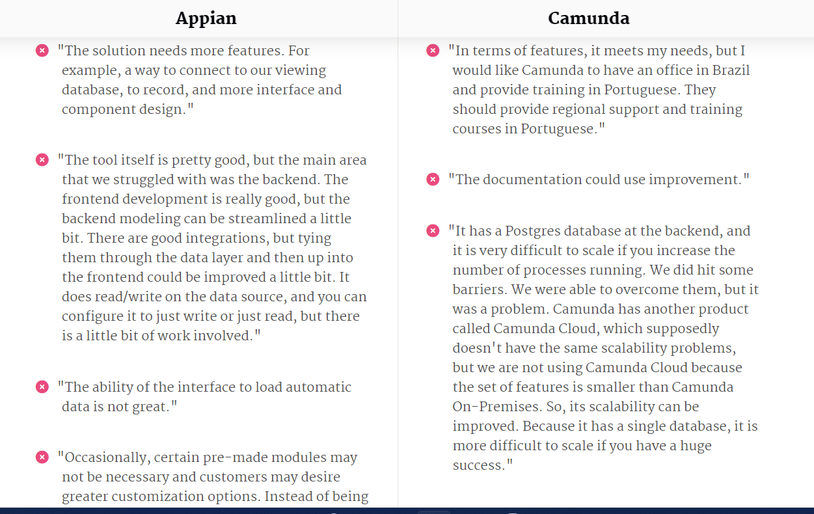
Appian vs Camunda - Cons

Slide 35
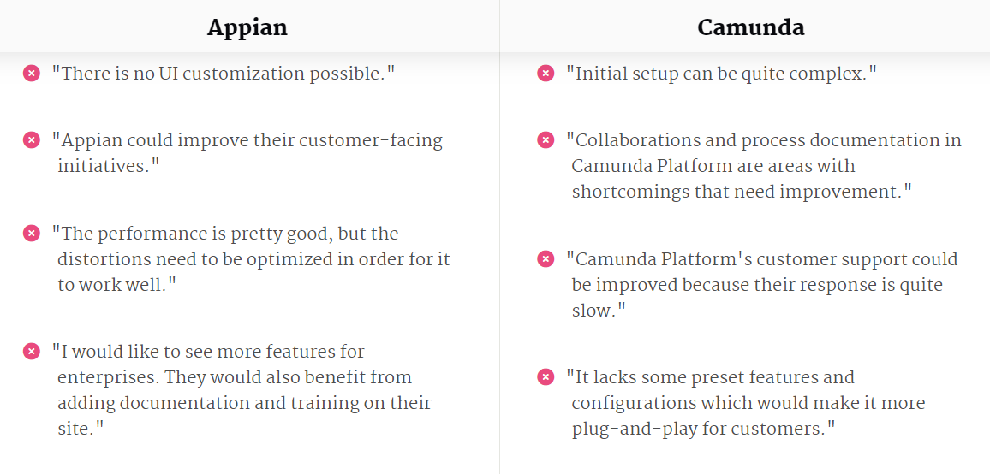
Appian vs Camunda - Cons

Slide 36


Slide 37
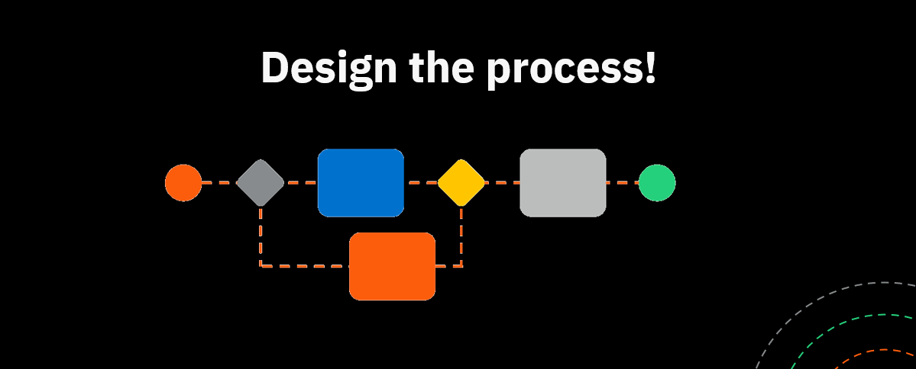

Slide 38
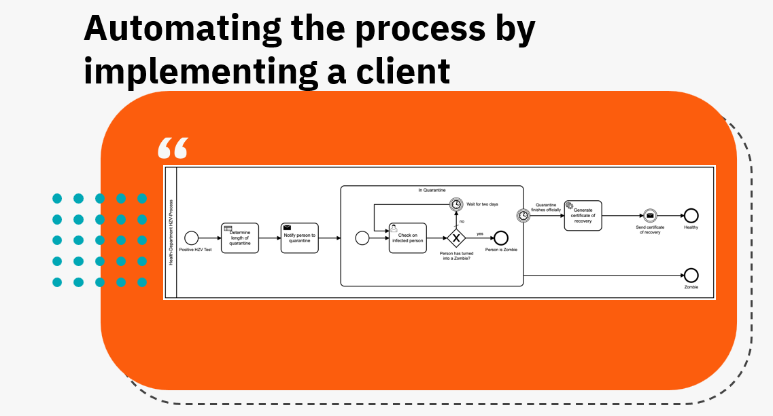

Slide 39
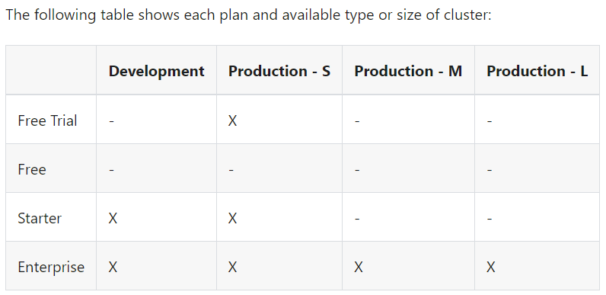
Clusters
A cluster is a provided group of nodes that run Camunda 8.
By default, Camunda 8 clusters are production-ready.

Slide 40
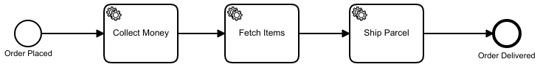
BPMN 2.0
Sequences

Slide 41
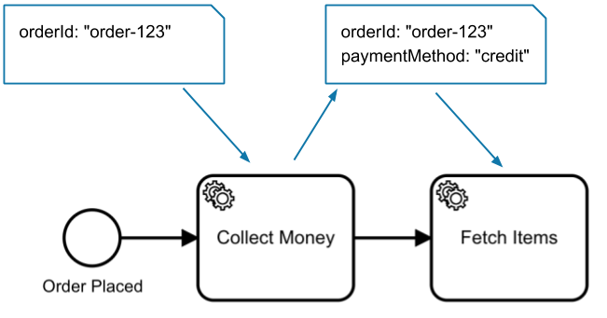
BPMN 2.0
Data flow

Slide 42
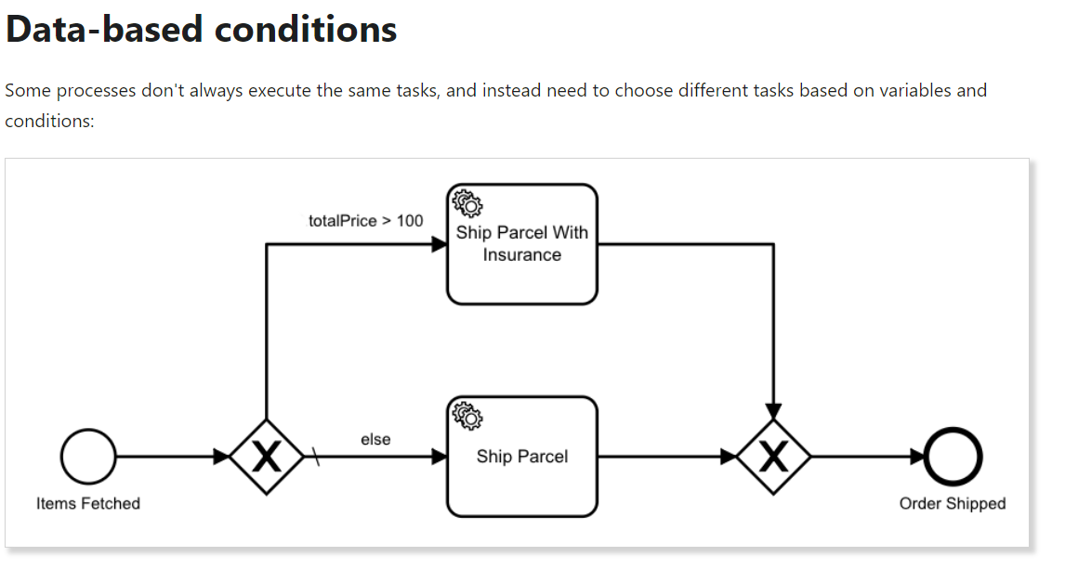
BPMN 2.0

Slide 43
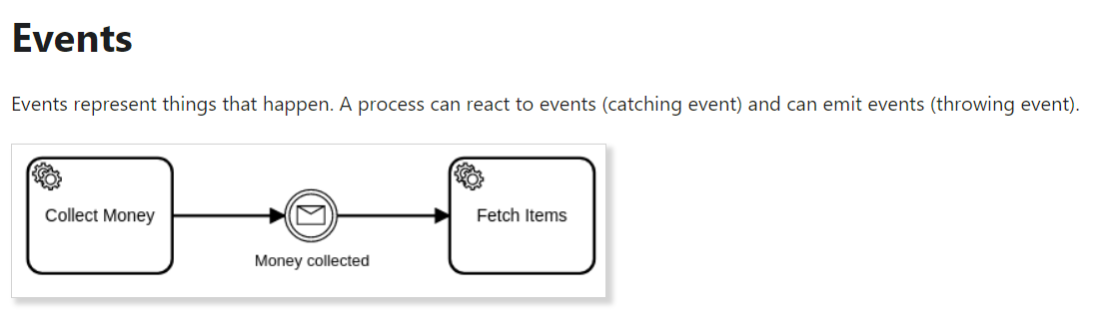
BPMN 2.0

Slide 44
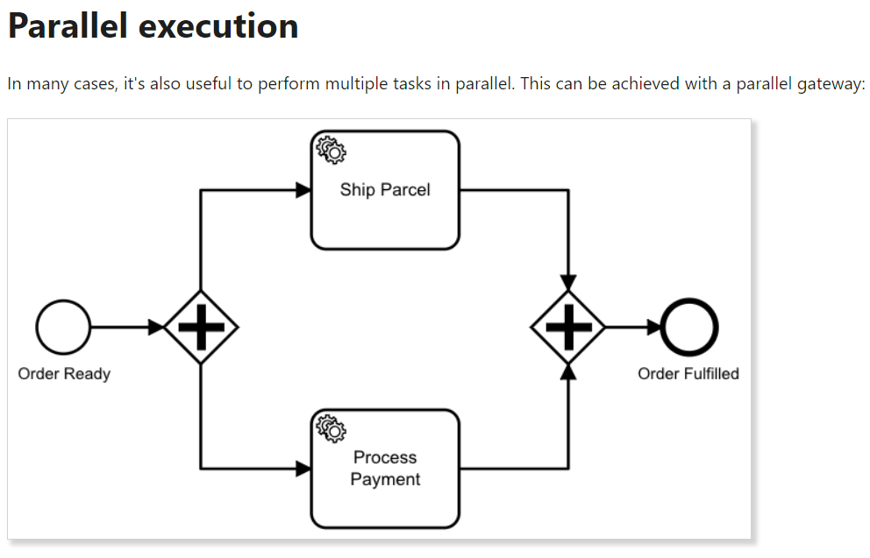
BPMN 2.0

Slide 45
Process Information
Step 1
http://localhost:8081/api/login?username=demo&password=demo
Step2
http://localhost:8081/swagger-ui.html
Or
curl -c cookie.txt -X POST "http://localhost:8081/api/login?username=demo&password=demo"

Slide 46
Spring boot Elastic
H:\git\repository\boamsdec2021\elkmsdemo
https://www.elastic.co/guide/en/elasticsearch/reference/7.17/rest-apis.html

Slide 47
Job Workers
A job has the following properties:
Type: Describes the work item and is defined in each task in the process. The type is referenced by workers to request the jobs they can perform.
Custom headers: Additional static metadata that is defined in the process. Custom headers are used to configure reusable job workers (e.g. a notify Slack worker might read out the Slack channel from its header.)
Key: Unique key to identify a job. The key is used to hand in the results of a job execution, or to report failures during job execution.
Variables: The contextual/business data of the process instance required by the worker to do its work.

Slide 48
Questions

